Slide 1



Auto-scaling
&
Cloud formation

Slide 2


Learning Objectives for this Session
What is Load Balancer
Types of load Balancer
Concept of Launch Configuration
Concept of Auto-scaling Group
Use case
What is Cloud formation
Benefits
How its work
infrastructure as just code {;} json
Demo

Slide 3



What is Load Balancer
A load balancer accepts incoming traffic from clients and routes requests to its registered targets (such as EC2 instances) in one or more Availability Zones. The load balancer also monitors the health of its registered targets and ensures that it routes traffic only to healthy targets.
Load balancing improves responsiveness and increases availability of applications. A load balancer sits between the client and the server farm accepting incoming network and application traffic and distributing the traffic across multiple backend servers using various methods.

Slide 4
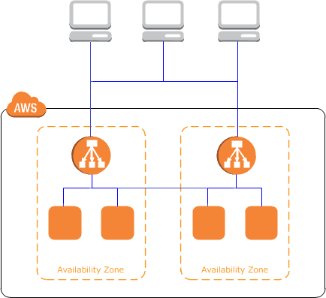
Types of load Balancer
Application
Load Balancer
Network
Load Balancer
Classic
Load Balancer
Application Load Balancer
Application Load Balancer is best suited for load balancing of HTTP and HTTPS traffic and provides advanced request routing targeted at the delivery of modern application architectures, including microservices and containers. Operating at the individual request level (Layer 7), Application Load Balancer routes traffic to targets within Amazon Virtual Private Cloud (Amazon VPC) based on the content of the request.
Network Load Balancer
Network Load Balancer is best suited for load balancing of Transmission Control Protocol (TCP) and Transport Layer Security (TLS) traffic where extreme performance is required. Operating at the connection level (Layer 4), Network Load Balancer routes traffic to targets within Amazon Virtual Private Cloud (Amazon VPC) and is capable of handling millions of requests per second while maintaining ultra-low latencies. Network Load Balancer is also optimized to handle sudden and volatile traffic patterns.
Classic Load Balancer
Classic Load Balancer provides basic load balancing across multiple Amazon EC2 instances and operates at both the request level and connection level. Classic Load Balancer is intended for applications that were built within the EC2-Classic network.

Slide 5
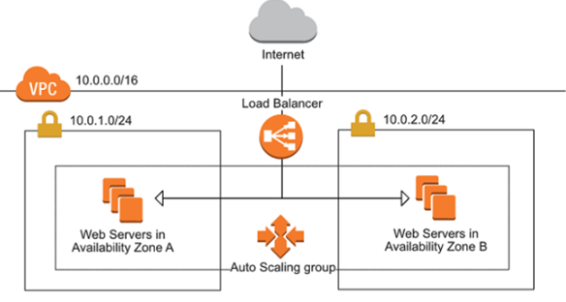

Concept of Auto-scaling Group
You can use scaling policies to increase or decrease the number of instances in your group dynamically to meet changing conditions. When the scaling policy is in effect, the Auto Scaling group adjusts the desired capacity of the group and launches or terminates the instances as needed. You can also manually scale or scale on a schedule.
You can use scaling policies to increase or decrease the number of instances in your group dynamically to meet changing conditions. When the scaling policy is in effect, the Auto Scaling group adjusts the desired capacity of the group and launches or terminates the instances as needed. You can also manually scale or scale on a schedule.

Slide 6

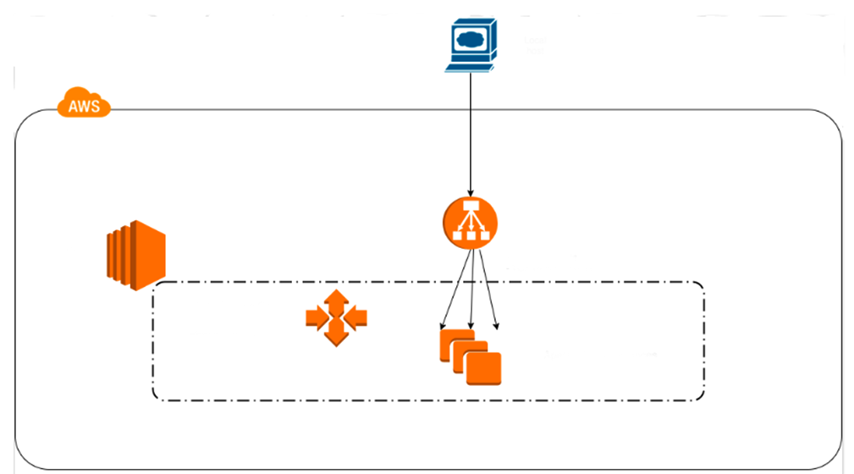
Concept of Launch Configuration
A launch configuration is an instance configuration template that an Auto Scaling group uses to launch EC2 instances. When you create a launch configuration, you specify information for the instances. Include the ID of the Amazon Machine Image (AMI), the instance type, a key pair, one or more security groups, and a block device mapping. If you've launched an EC2 instance before, you specified the same information in order to launch the instance.
You can specify your launch configuration with multiple Auto Scaling groups. However, you can only specify one launch configuration for an Auto Scaling group at a time, and you can't modify a launch configuration after you've created it. To change the launch configuration for an Auto Scaling group, you must create a launch configuration and then update your Auto Scaling group with it.
Local
host
Elastic Load
Balancer
(ELB . Classic)
EC2
HTTP Requests
TCP Health Checks
Auto Scaling Group
With
Launch Configuration
Apache Linux Instances
“Stress” test triggers Scale
Up/Down

Slide 7
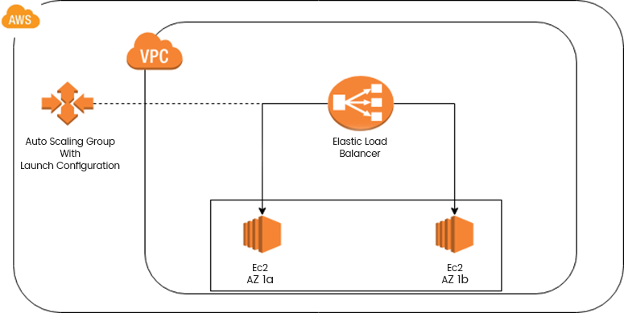

How to use auto Auto-scaling group and Launch Configuration with ELB AWS
You can automatically increase the size of your Auto Scaling group when demand goes up and decrease it when demand goes down. As the Auto Scaling group adds and removes Amazon EC2 instances, you must ensure that the traffic for your application is distributed across all of your instances. The Elastic Load Balancing service automatically routes incoming web traffic across such a dynamically changing number of instances. Your load balancer acts as a single point of contact for all incoming traffic to the instances in your Auto Scaling group.

Slide 8


What is Cloud formation
AWS CloudFormation provides a common language for you to describe and provision all the infrastructure resources in your cloud environment. CloudFormation allows you to use a simple text file to model and provision, in an automated and secure manner, all the resources needed for your applications across all regions and accounts. This file serves as the single source of truth for your cloud environment.
AWS CloudFormation is available at no additional charge, and you pay only for the AWS resources needed to run your applications.

Slide 9

Benefits
MODEL IT ALL
AUTOMATE & DEPLOY
IT'S JUST CODE
AWS CloudFormation allows you to model your entire infrastructure in a text file. This template becomes the single source of truth for your infrastructure. This helps you to standardize infrastructure components used across your organization, enabling configuration compliance and faster troubleshooting.
AWS CloudFormation provisions your resources in a safe, repeatable manner, allowing you to build and rebuild your infrastructure and applications, without having to perform manual actions or write custom scripts. CloudFormation takes care of determining the right operations to perform when managing your stack, and rolls back changes automatically if errors are detected.
Codifying your infrastructure allows you to treat your infrastructure as just code. You can author it with any code editor, check it into a version control system, and review the files with team members before deploying into production.

Slide 10
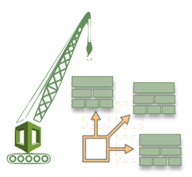

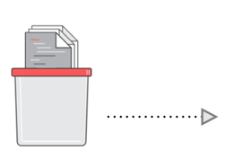
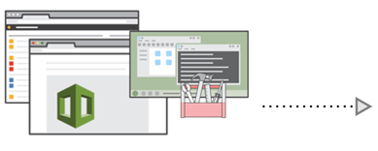

How it works
Code your infrastructure from
Scratch with the CloudFormation
template language,
In either YAML or JSON format,
Or start from many available
Sample templates
Check out your template
Code locally, or upload it
Into an S3 bucket
Use AWS CloudFormation
Via the browser console,
Command line tools or APIs
To create a stack based
On your template code
AWS CloudFormation
Provisions and configures
The stacks and resources
Your specified on your template

Slide 11

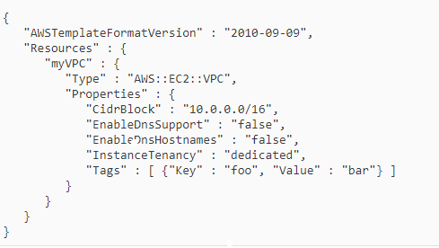

infrastructure as just code structure

Slide 12

CloudFormation Use Case
This template creates an instance with a security group that allows global SSH access (port 22), but uses a keypair to log in. It requires two parameters, MyImageId, which is the image ID of the instance to create, and MyKeyPair, which is the name of the keypair to use to log in with. You can use both values with the euca-run-instances command to create an instance manually (for example, euca-run-instances -k mykey emi-db0b2276) so the arguments needed here are standard instance arguments.

Slide 13



Thank you
Happy Learning

